Slide 1

The Metabolic Syndrome

Slide 2
A cluster of risk factors that, when they appear together, dramatically raise your risk of:
Heart disease, heart failure,
        Stroke and
        Diabetes,
        Non-cardiovascular conditions.
Nearly one in three Americans have metabolic
syndrome.
Many people don’t recognize that they have the
condition and underestimate the risks it presents.

Slide 4
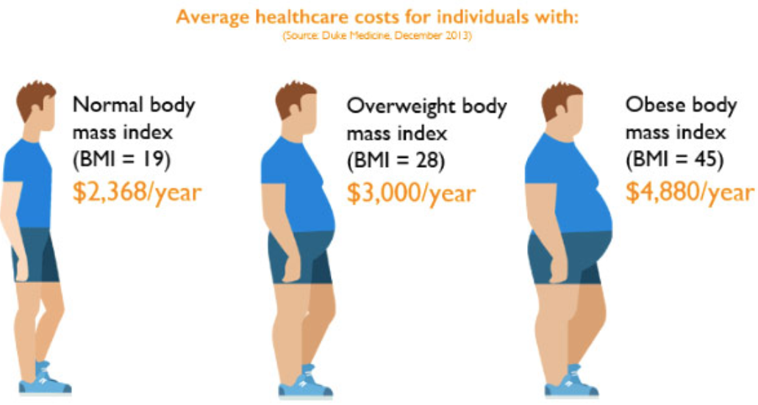

Slide 5


